Slide 1
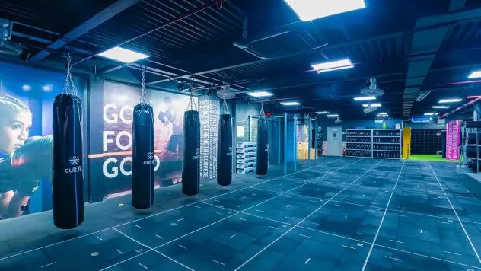
Cult Fit Referral Program
Product Teardown
by
Abhishek Banerjee

Slide 2


Ecosystem Overview
Product Description
Cult fit is a one stop solution for one- stop-shop for fitness enthusiasts, offering a wide range of services that
include workout sessions, yoga classes, meditation programs, and healthy meal plans
Indian Fitness Market
Indian fitness market stands at $23 million and aims to reach $36 million by 2029 at a CAGR of 6.05%
Growth of the market is driven by rising diseases, government initiatives to promote fitness and popularity of fitness applications and tech gadgets
Hinderance to this growth happens to be high operational costs, lack of certified trainers to ensure safety and well being of the customers
Key stakeholders
14Million downloads
100,000
active users
4.2 Rating
Gym owners Consumers Nutritionist Wellness clinics Government bodies
Working professional, especially the millennials and the GenZ have understood the importance of fitness and has added it to their way of life. The digitization of fitness regime , spreading fitness beyond the realms of gymnasiums, goes well with the routine of the youth and Cult fit does hit the spot on this aspect.
600+
centers
694 Cr
revenue in FY 2023
Valued at
$1.5 billion

Slide 3


Cult.fit: Overview
Business Model
Cult’s business model is multi dimensional as it encompasses both physical and digital realm through fitness centres accompanied by a intuitive application. Following are the aspects of their model:
Service Offered
Value Proposition
Gym
Cult fit intends to make fitness more enjoyable and accessible, ensuring a healthier lifestyle.
While providing an array of different fitness regimes for the user to choose as per their preference, Cult also focuses on mental health through meditation programs
Yoga
Diverse offering: Provides a wide range spanning from intense work out to relaxing meditations
Accessibility: The Cult app enables users to plan their sessions instantly Community building: Group sessions is a nice way of engaging like minded fitness enthusiasts
Holistic approach: Focusing on holistic wellness of their consumers
Sports
Revenue Channels
Digital Fitness
Dance
Fitness Centers
Merchandizing
plans
Wellness Programs
Corporate offerings
Swimming
Food services

Slide 4





Competitor Analysis
How is Cult Fit Different?
While its competitors focuses on a single aspect, Cult fit stands out as a super app with all facilities available which a user can think of.
More over, it has nailed brand positioning by identifying itself as a beacon of trendy cool lifestyle. Affiliation to major fitness brand like HRX helps them stand out as a sought after brand
Cult.fit diversified its revenue channel through Eat.fit and Mind.fit targeting a holistic development of the consumers , while its competitors are stuck to a single channel for revenue.
HealthifyMe: Focuses on workout plans and diet plans
Gold’s Gym:
Chain of training centres specializing in fitness programs
Anytime Fitness: Focuses on ease of usage for the gym members
F45 Training: Focuses on high intensity group workouts
Talwalkars:
Focuses on extensive network of fitness centres

Slide 5


User Persona
Cult fit is heavily used by millennials and Genz with around 69% userbase within the age of 18-24
Milind Mehra: Age: 28
Software Engineer
Background:
Apart from his routine schedule, Milind likes to stay active. He is into fitness and has a passion for dance and travel
Pain Points:
Similar gym routines daily tends to be monotonous
No time to pursue passion for dance There is no structured plan to follow
Goals:
An option to try variations in fitness routines
A provision to pursue passion without impacting daily routine A structured fitness journey to gauge progress
Pallavi S:
Age: 32 Marketing Manager
Background:
Originally from Vijaywada, currently based in Mumbai for professional reasons. She has a hectic schedule and barely gets time to herself
Pain Points:
Health issues arising due to lack of fitness Unable to plan time
Goals:
An option to plan workouts as per discretion
for fitness due to work schedule
No motivation to devote time to fitness
A community to share fitness goals with
An option to address mental stress that is a by product of any profession

Slide 6
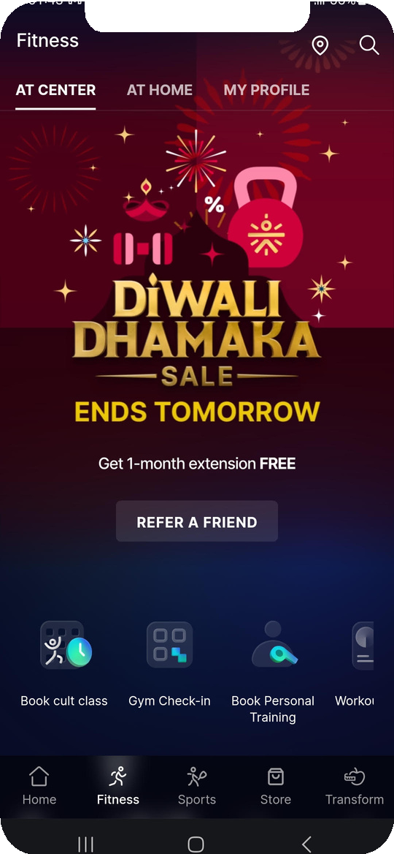

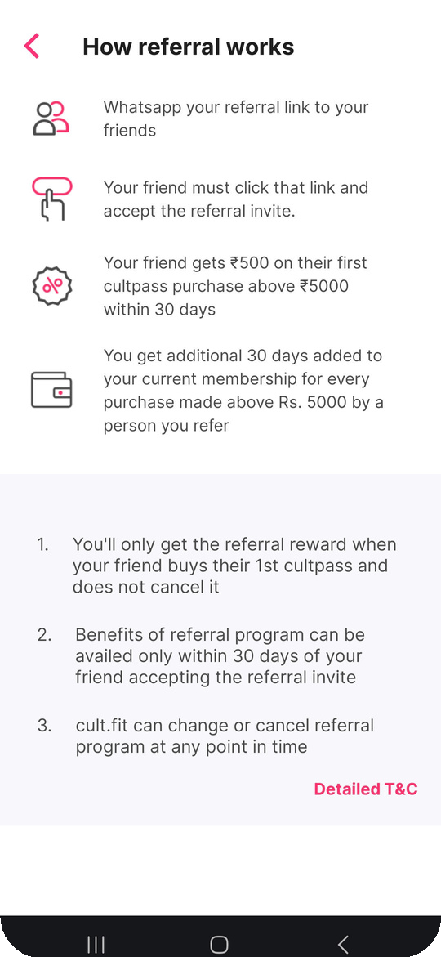
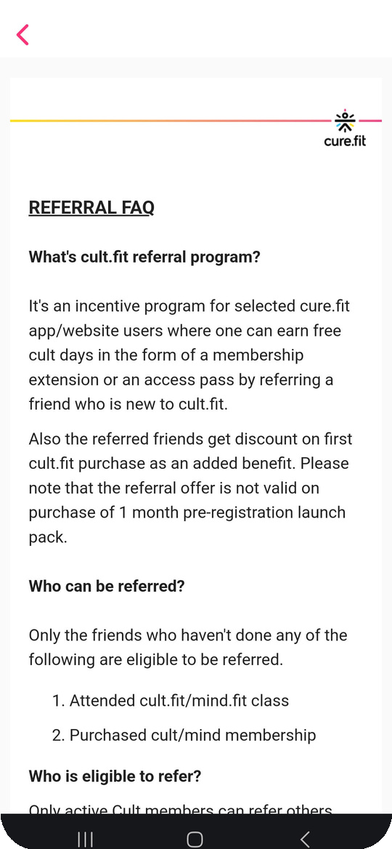
Referrer’s journey of a Referral Program
Referrer is an active user of the product and will be motivated to share his experience with known circle

Slide 7
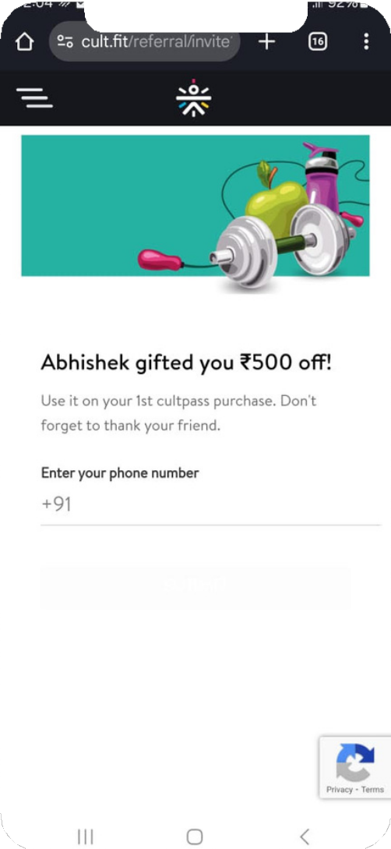
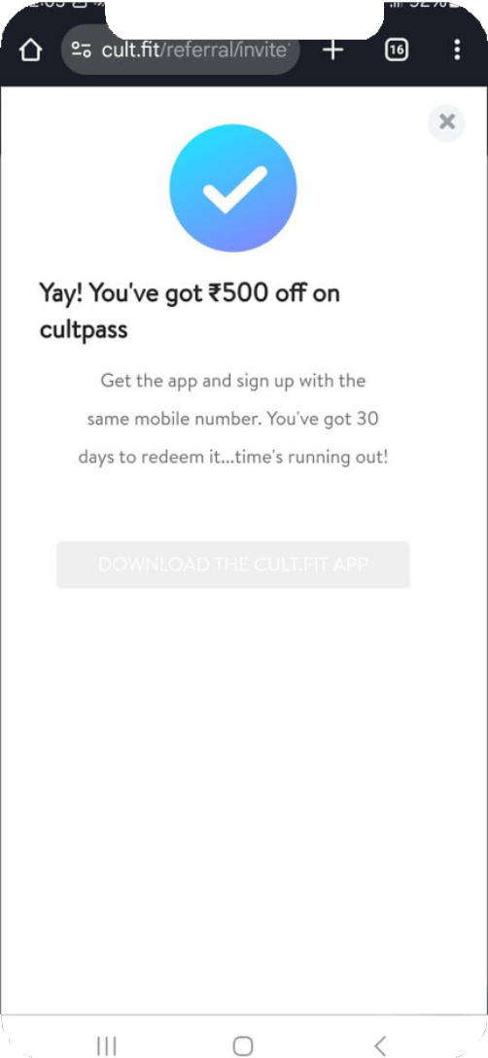
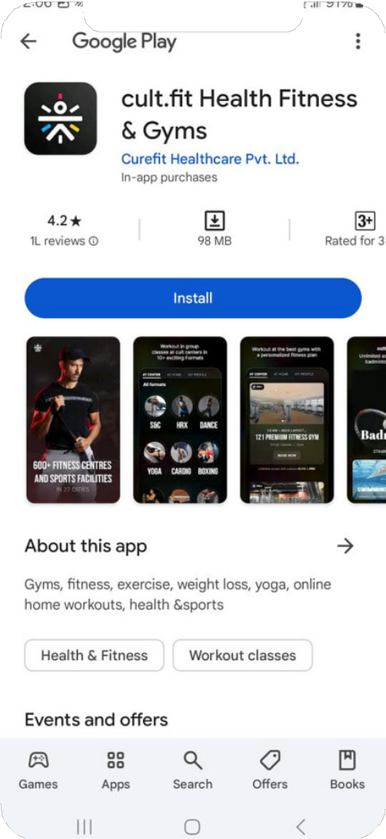
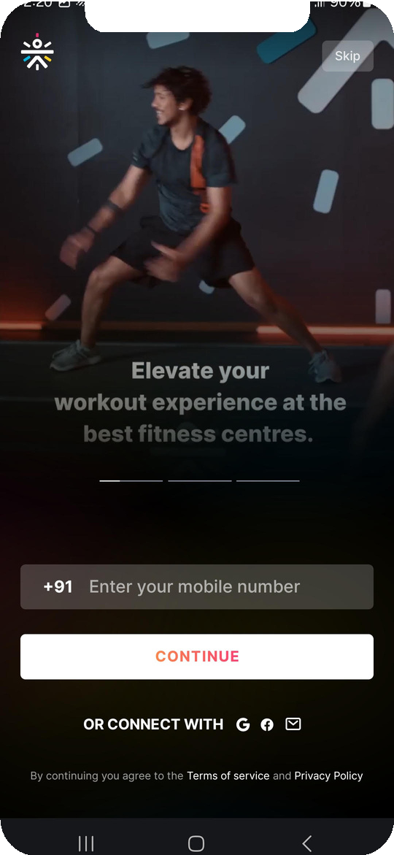
Referee’s journey of a Referral Program
Referee is the user persona receiving a referral and is a potential customer that the business can onboard

Slide 8
User Journey Analysis
Awareness
Clicks on a referral link and gets introduced to the application
Referral link Curious , Unsure
No motivation to use the application
Provide an incentive upfront to motivate the user
Consideration
Enter contact details to redeem the referral link
Referral code user interface
Intrigued
Ambiguity on how to avail the benefit
Text to clearly mention on what needs to be done to avail the benefit
Decision
Install application and sign up
Appstore/Playstore Excited
Lack of clarity on multiple options available on the application
Mini video playing on the onboarding page on loop
Service
Purchase membership pass
Application home page
Motivated
Overwhelmed with multiple options on the application
Each service offering has a section with Walk Me available to guide user
Loyalty
User sends a referral link
Application refer a friend section, WhatsApp
Happy Unclear if the referral
program will be beneficial
for the user
Concise information available on the benefits that both referrer and referee can achieve through the referral program
User Action
Touchpoints
User emotion
Pain Point
Solution

Slide 9
Metrics
A referral is considered successful when a referee purchases its first pass within 30 days of accessing the referral link
Key Metric
Conversion Rate = ((No. of passes purchased through referral link)/(#total referral link shared))*100
Other Metrics
Participant Share Rate: It is helpful to understand how motivated are active customers to refer the product within their circle. It is crucial to boost this metric as referral is a very effective way of generating leads
Participation Share Rate = (No. of users referring)/(Total no. of users)
Referral Click rate: It will help us gauge if the referral link is appealing to the new user. Also it will be helpful to identify which channel is more effective in terms of getting a conversion
Referral Click Rate = (No. of referral links clicked)/(Total no. of referrals sent)
Referral Revenue: It is an important metric to gauge if the product is able to reap benefits of the investment done to enable a referral program
Referral Revenue = Total Revenue from referral - Cost of acquiring referrals

Slide 10
Observations
Highlights
Improvements
Cult Fit clearly highlights that it has a two- sided referral program
It clearly outlines how the referral program will work for both stakeholders, i.e. : the referrer and the referee
To avoid any ambiguity, they have outlined all possible queries that a referrer might have and provided clear answers
Cult fit is very particular about the kind of users who should be entrusted with referral and hence they have made the option limited to regular users
For referee, they mention who has referred them and shares the incentive immediately and tries to increase bonding between the two stakeholders
On the referrer side, they can display the reward which is the FitCash and also a leaderboard highlighting top referrers to gamify the experience
There should be option for sharing the link through other social media application such as Instagram
On the referee end, the activation button can be colour coded better while its inactive
Along with incentive, a mini clip of the experience that Cult fit can help referee make an informed decision. The white space can be better utilized

Slide 11
Thank You

